Slide 1
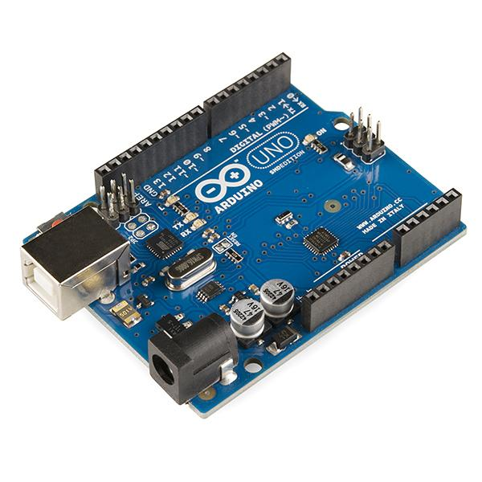
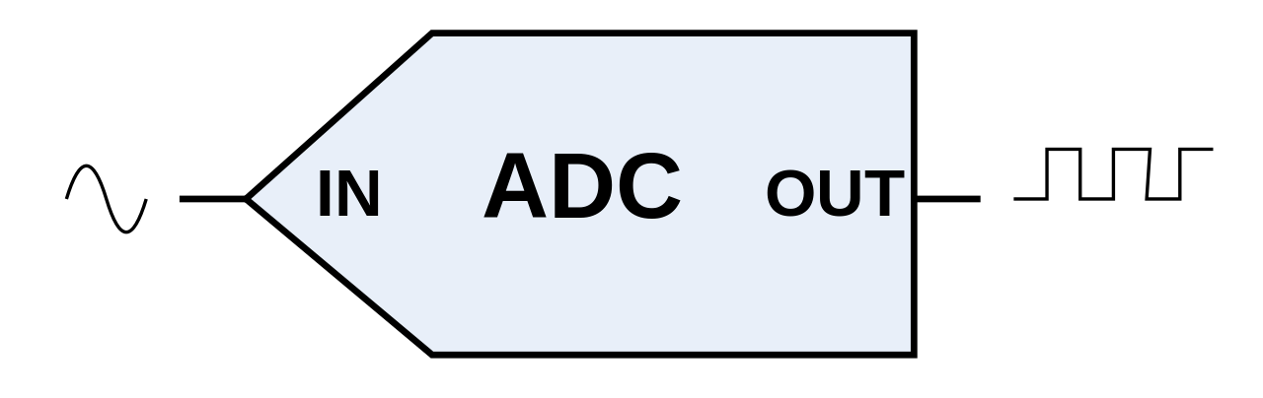
Virtual Workshop 2
Analog to Digital Conversion and Arduino
Penn State IEEE
Workshop 2
September 17, 2020

Slide 2
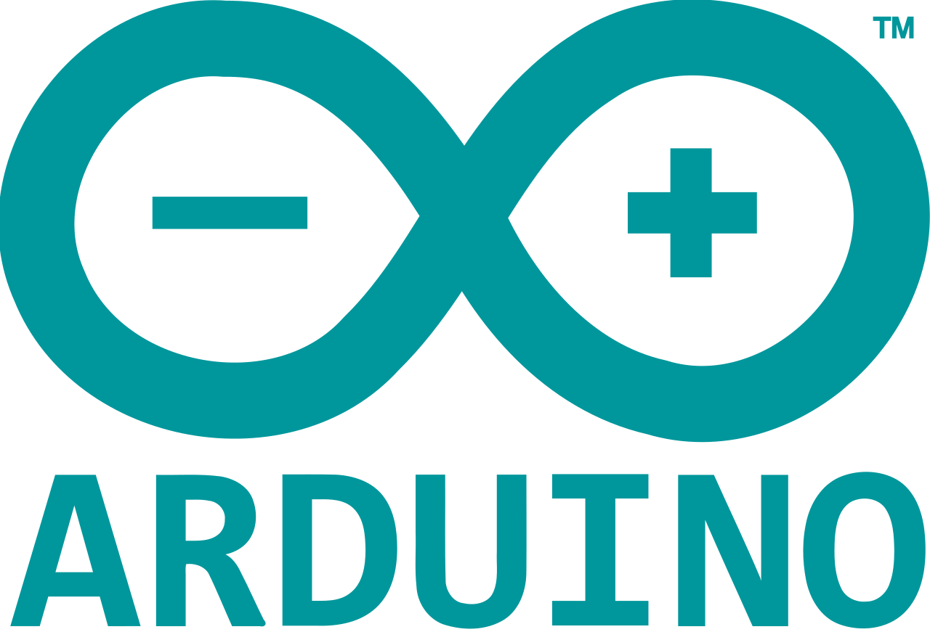
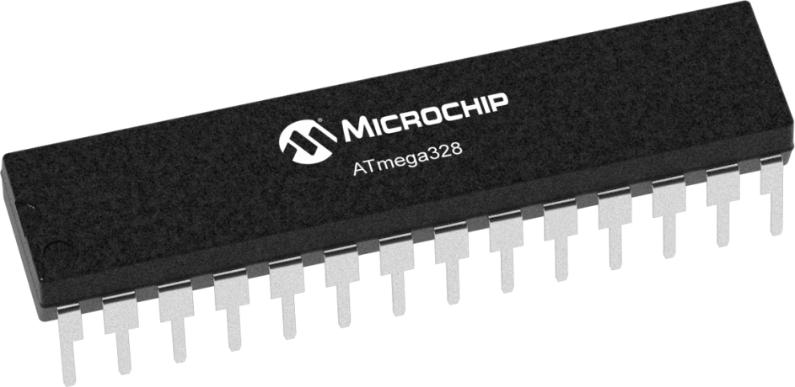
Arduino Basics
The Company
Hardware and Software company
Best known for their AVR-based boards
Uno
Nano
Mega
Useful in many electronics projects
Notes:
Arduino is a hardware and software company that designs a variety of development boards and controllers. They are best known for their AVR-based boards such as the Arduino Uno, Nano, Mega, and more. The AVR series of microcontrollers was developed by Atmel in the late 90s, and is a cheap and compact microcontroller solution that can be useful in a wide variety of electronics projects. AVR chips can be difficult for beginners to program on their own, but Arduino boards make it much easier to program and interface with them. Since the project is open source, other companies can make their own versions of Arduino boards, sometimes with extra features.
At the bottom you can see an example of an AVR microcontroller, the ATmega328. This is the same chip that’s used in the Arduino Uno

Slide 3
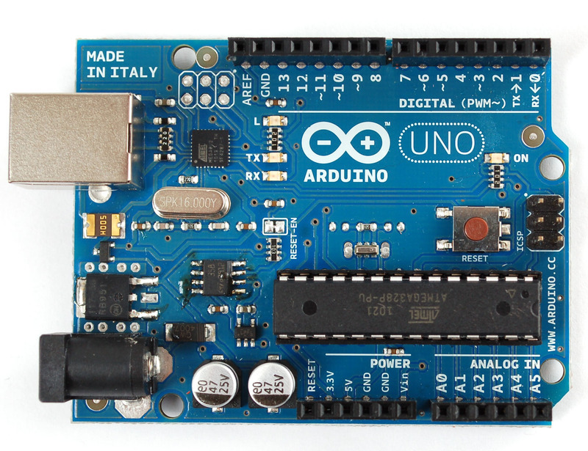
Arduino Basics
The Board
Arduino Uno
Digital and Analog Pins
Digital works with high/low signals
Analog works with “smooth” values
Serial Monitor
Allows for communication between Arduino and other devices
Notes:
The Arduino can send and receive signals using the connections on the board. On the Arduino Uno, you may interface with the controller using 14 digital connections and 6 analog connections. The digital pins can be used to send or receive high or low signals, such as receiving a high signal from a button press or sending a high signal to turn on an LED. The analog pins, however, can be used to measure the voltage of an incoming signal or, in certain cases, send a specific voltage using a PWM signal.
The Arduino also can communicate with other devices using the built-in serial monitor. For example, an Arduino could report back data from a temperature sensor to a connected computer. We will see an example of this in a few slides.

Slide 4
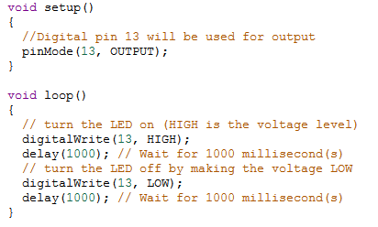
Arduino Basics
Programming your Arduino
Uses C++ syntax
Must have a setup() and loop() function
setup() is run once
loop() is run after setup() and runs forever
Notes:
Arduino boards are programmed using a modified version of C++.
All Arduino sketches must have a setup() and loop() function.
setup() runs once, and is often used to tell the Arduino some initial conditions for the project. For example, which pins are going to be used for input or output, and starting a serial connection.
loop() is where the fun stuff goes. loop() runs after setup() and runs over and over

Slide 5
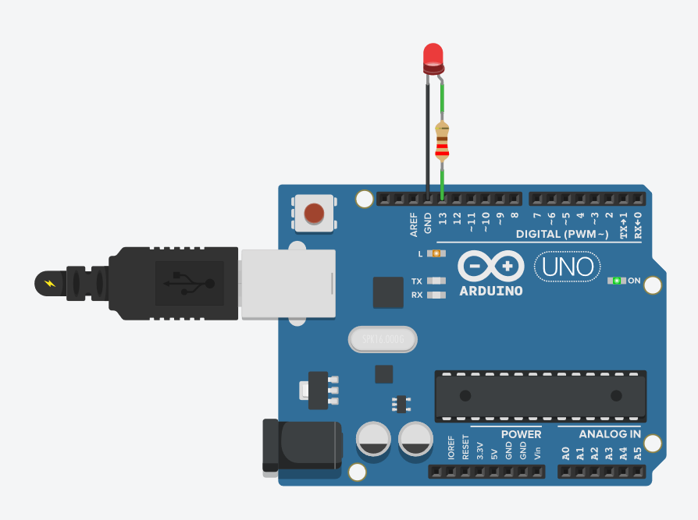
Arduino Basics
Blink Example
Notes:
we have an led connected from pin 13 to ground
setup()--> we tell the arduino that pin 13 will be used for output
loop()--> send a high signal out from pin 13, which turns on the led
wait 1000ms(1 second)
send a low signal from pin 13, which turns off the led
wait another 1000ms
go back to the start of loop and do it over again

Slide 6
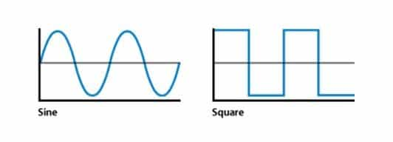

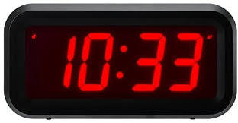
Analog vs. Digital
Analog
Continuous signal
Denoted by sine wave
Represents physical, real-world data
More detailed and refined
Susceptible to noise
Lower quality signal
Digital
Segmented signal
Denoted by square wave
Represents binary, discrete data
Easy for computers to read and process
Less susceptible to noise
Higher quality signal
Notes:
Analog data is data which exists as a continuous signal (denoted by a continuous sine wave) that represents physical measurements. The world is “in” analog; that is information and data are constantly flowing and changing. Analog represents more detailed and refined information. However, analog is very susceptible to noise (interference) and also tends to have a lower quality signal than equivalent digital signals.
Digital data is data which exists only in binary (0’s and 1’s) denoted by a square wave. This means that the signals are time-separated and non-continuous. This type of signal is extremely easy for computers to read and write in. Digital represents discrete numbers (0 and 1) to represent information. Digital signals are less susceptible to noise since there are only two states which they are represented in and generally have better quality signals.
ask for questions

Slide 7

What is ADC and how does it work?
What is ADC?
ADC stands for Analog to Digital Converter
Device which converts analog voltage to digital signal
Allows for easy data collection/analysis by computers
How does it work in an Arduino?
Analog input voltage charges internal capacitor
Monitors how many clock cycles pass until fully discharged
Number of clock cycles returned by Arduino
Outputs number in binary (2^10 or 10 bit for Uno)
Technique is called successive approximation
Numerical Output
Input voltage
Notes:
An Analog-to-Digital Converter (commonly abbreviated ADC) is a device which can convert varying analog voltages into digital signals so that they can be more easily read by digital devices. This allows us to collect information from real-world instruments and then analyze it digitally.
discuss the eqn, ask for questions

Slide 8
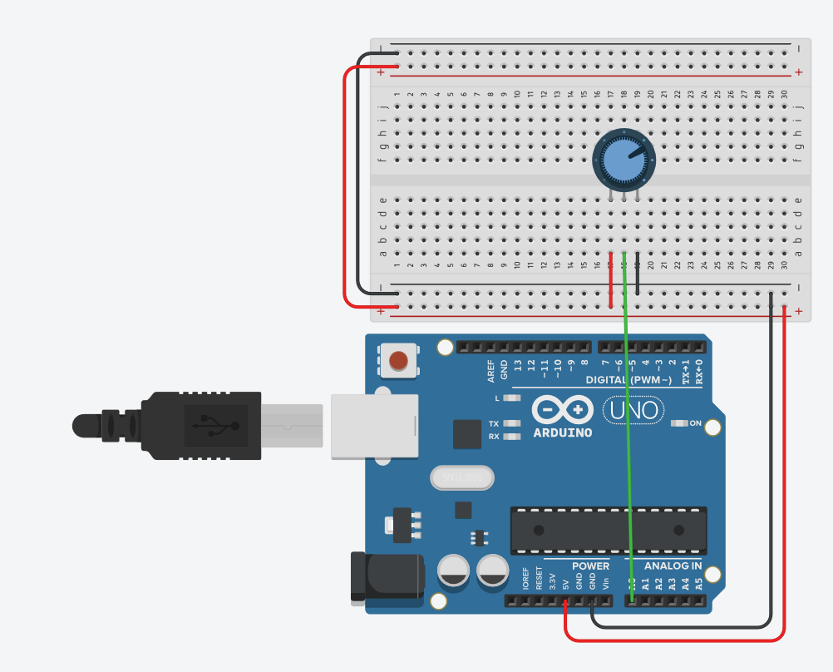
Arduino Basics
Pot to Percent Example
Notes:
Potentiometer is a resistor that changes depending on the position of the dial
When connected up to 5v, the potentiometer will send out from 0-5v depending on the position of the dial (see ohm’s law)
We can use this to have the arduino tell us a percentage based on the position of the dial
Arduino’s analog pins read voltages from 0-5v as a value from 0-1023
outside of our functions, we set a few important values: >>the maximum value for our adc, which we know is 1023
>>how we long to wait before checking the potentiometer again. We chose to set it to 1000ms.
setup()-->we begin a serial connection
loop()
get our percent value
the map function is used to scale a value from one range to another
for example, if we know a value is going to be from 0-10, but we want it to be from 0-100, the map function can help us. If the value is 5, the map function would scale it up to 50. If the value is 3, the map function would scale it up to 30, etc
analogRead(A0) gets the voltage coming off of the potentiometer, which is connected to Analog Pin 0 (A0)
the map function scales the value the arduino gets from the potentiometer (which we know must be from 0-1023) to a value from 0-100
print the percent value we calculated to the serial monitor
pause before checking again

Slide 9
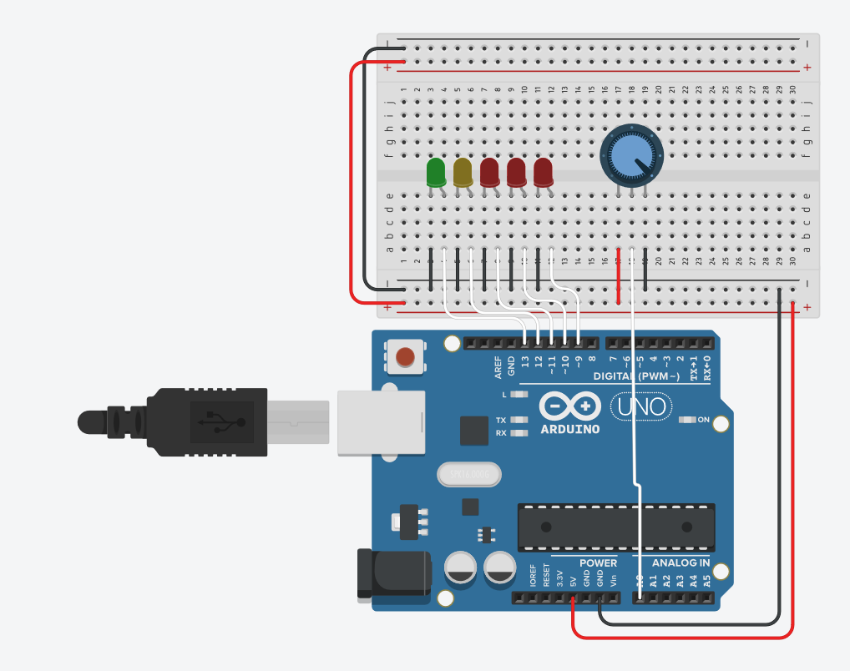
Arduino Basics
Pot to LED Example

